Slide 1

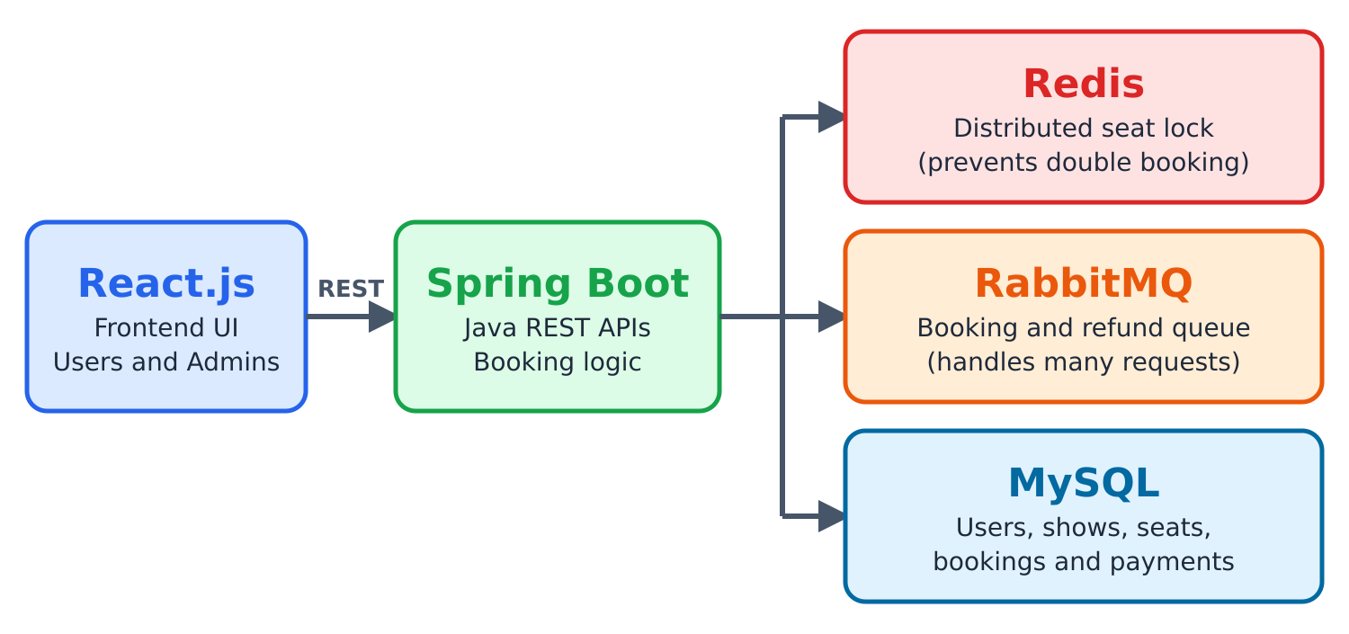
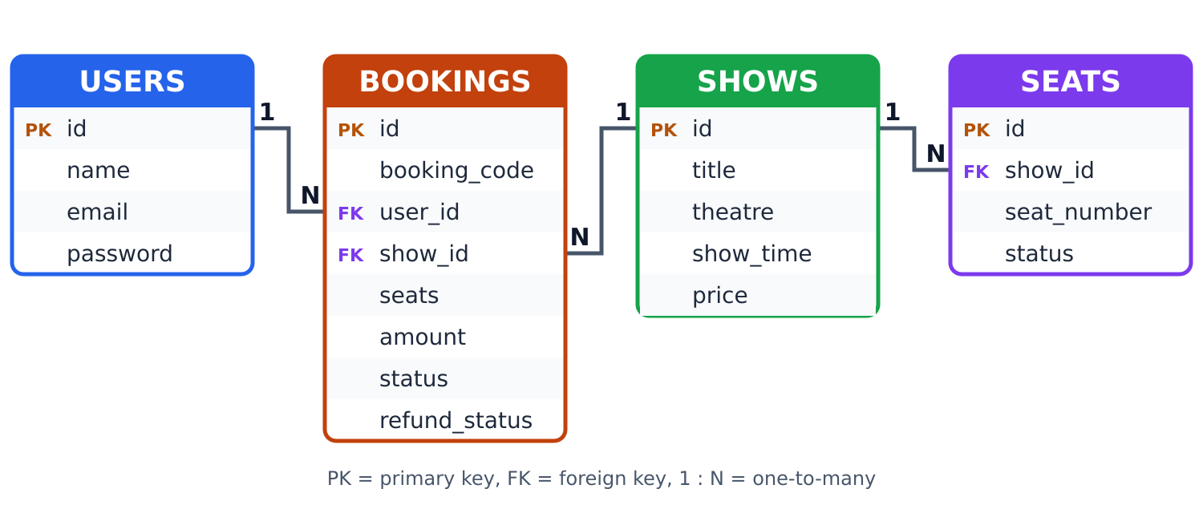
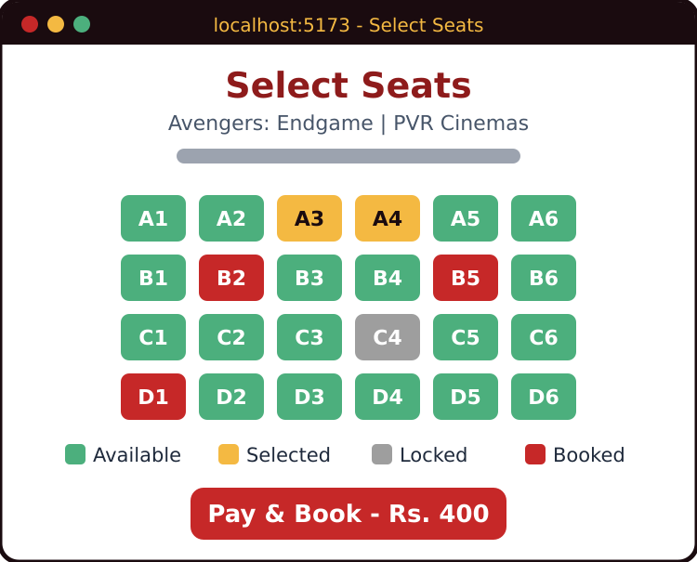
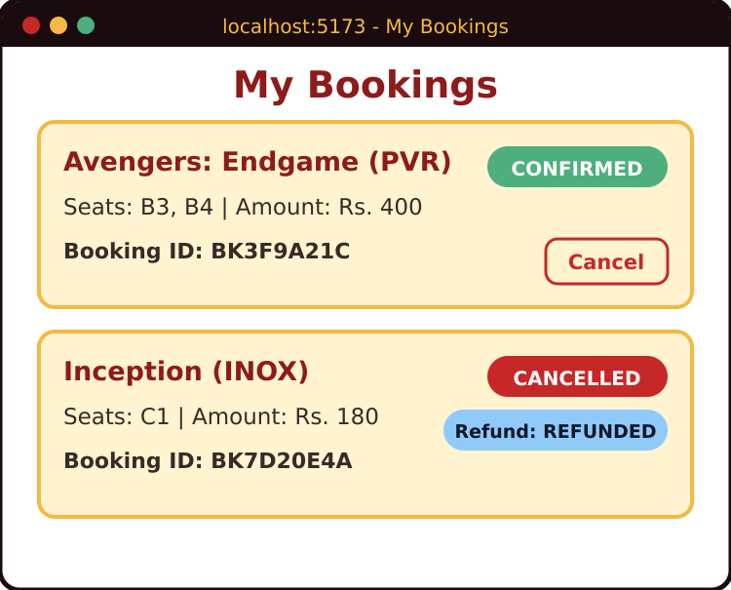
TICKET BOOKING SYSTEM
Team ID: 07 | Section: S3 | Members: Rayanki HimaVarshini – 2520030141, Gurrapu Nikshitha – 2520030512, Vemua Naga Venkata Sai Chandu – 2520030522 | Guide: Dr. Spandana
Database Systems Engineering and Distributed Backend Development (25CS1302E) | KLH Bachupally Campus, CSE | PBL 2026-27
Abstract
Tools & Technologies
Web application to browse shows, choose seats, pay and get a digital ticket; admins manage shows, seats and bookings.
Redis seat locking and RabbitMQ queues prevent double booking and handle heavy traffic.
Front-End: React.js
Back-End: Java + Spring Boot + REST APIs
Database: MySQL
Concurrency & Messaging: Redis (distributed lock), RabbitMQ (queue)
Tools: Maven, Postman, VS Code, Git & GitHub
Problem Statement & Objectives
Problem: Booking is manual or spread across platforms, and concurrent users can double-book or oversell seats.
Objective 1: One platform to browse shows, select seats and pay.
Objective 2: Prevent double booking with Redis seat locking.
Objective 3: Use RabbitMQ queues for load; support cancel and refund.
Scope: Users and admins; login, shows, seats, booking, payment, refunds, reports.
System Architecture
Existing vs Proposed System
Feature | Existing System | Proposed System
Booking | Counter or many sites | One online platform
Seat status | Not real-time | Live availability
Concurrency | Double booking risk | Redis seat lock
Traffic | Slow under load | RabbitMQ queue
Gap | Oversells, manual refund | Lock, queue, auto refund
ER Diagram & Database Design
Feasibility Study
Technical: Java, Spring Boot, React, MySQL, Redis and RabbitMQ; all run on a laptop using Docker.
Economic: Open-source stack and free tools (VS Code, Postman); no licence cost.
Operational: Simple interface for users and admins; easy to maintain and extend.
Schedule: Auth, shows, booking and queue modules built step by step within the trimester.
Implementation Screenshots
Results & Testing
Conclusion
Future Scope
Test cases: login, booking, cancellation and refund.
Concurrency test: two users book one seat; only one succeeds.
Secure, scalable system that prevents double booking and overselling.
Meets the objectives: one platform, seat locking, queued requests, refunds.
Real payment gateway (UPI, cards)
Mobile app, email and SMS alerts
Cloud deployment and analytics
References: [1] Spring Boot Reference, spring.io/projects/spring-boot [2] Redis Distributed Locks, redis.io/docs [3] RabbitMQ Documentation, rabbitmq.com/docs [4] React Documentation, react.dev
QR: GitHub

